Slide 1
Cross-sectional variation in the earnings response coefficient:
Current evidence from S&P500 companies
Bianca Minuth
3rd Assignment
Research on Corporate Transparency

Slide 2
Earnings Response Coefficient (ERC) & Estimation
Earnings Response Coefficient (ERC) measures the response of stock prices to earnings announcements and is the stock price change associated with an unexpected earnings change.
ERCs are expected to be an increasing function of the extent an earnings announcement results in a revision in expected earnings and a decreasing function of the expected rate of return.
CAR = a + bUE, + e; where CAR is a measure of risk-adjusted return for security i cumulated over period t, UE is a measure of unexpected earnings, and b as ERC.
Sample: WRDS Data (Compustat, CRSP, I/B/E/S) from 11/2019 - 12/2020
Estimation of ERC focusing on the year 2020:
Cumulative Abnormal Returns (CAR) around the earnings announcements (event date)
with a 3-day-window of CAR[-1;1]
with a 4-day-window of CAR[-3;0]
both with an estimation window of 250 trading days prior to the event date
S&P500 price change as a benchmark.
Unexpected earnings (UE) as actual announced EPS minus analysts’ (first) estimation prior to the announcement.

Slide 3
ERC & Determinants
Influencing determinants for variations in ERC could be:
Increasing risk (beta) → Decreasing ERC
Increasing debt → Decreasing ERC
Increasing growth → Increasing ERC
Increasing earnings persistence → Increasing ERC
Increasing accrual quality → Increasing ERC
These factors might show variations within sectors.

Slide 4
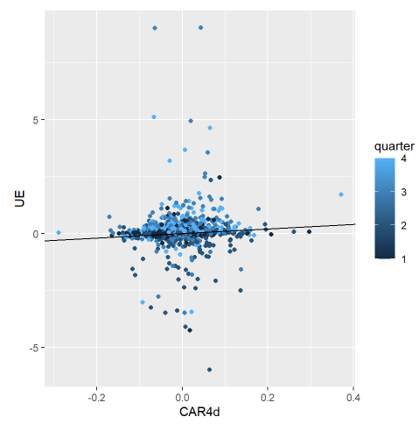
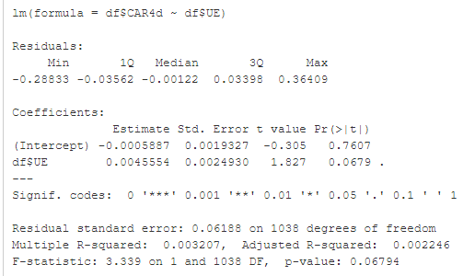
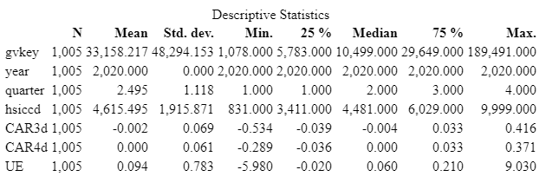
Figure I: Regression CARs and UE, year = 2020
Results (1/2)
CAR [-3;0] on a 4-day-window level turned out to be more representative, thus the following regression refers to CAR4d (refer to Table I).
Table II shows a positive ERC, statistically significant on a 10% level for CAR4d ~ UE.
Table II: Regression CAR4d and UE, year = 2020
Table 1: Descriptive statistics for the year 2020

Slide 5
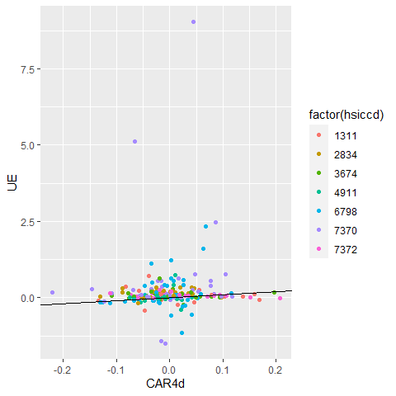
Results (2/2)
Figure II: Regression CAR4d and UE, showing the most represented sectors (hsiccd) in Q42020
Figure II shows the sectors that were most represented in the dataset (No. of companies within sectors).
Plotting the regression of CAR4d and UE highlighting different sectors at Q42020 and different quarters within the year 2020, show a diverse picture which could explain the variation in ERC (Figure II).
Sector 7370 shows a high ERC that might be related to high growth firms, same as sector 7372.
Other displayed sectors might result in a higher ERC due to lower risk, debt and higher accrual quality.
Crude Petroleum and Natural Gas
Pharmaceutical Preparations
Semiconductors and Related Devices
Electric Services
Real estate investment trust
Prepackaged Software
Cmp programming, data process

Slide 6
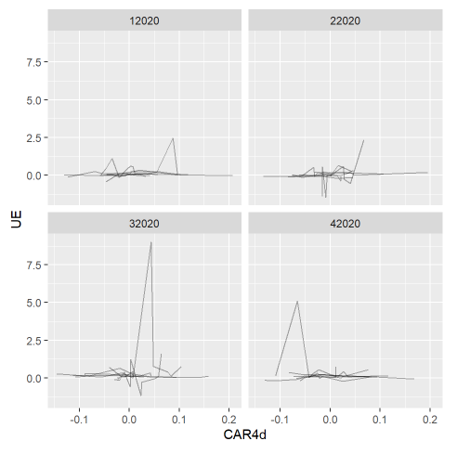
ERC cross-sectional interpretation & Limitations
Figure III: CAR4d and UE per quarter Q1-Q4 2020 showing most represented sectors
ERC in 2020 was shown to be an increasing function of the extent an earnings announcement results in a revision in expected earnings (sign: 10% level), indicating there is information in the announcements.
The variations might be explained by the differences between the sectors and quarters (see also Figure IV).
The cross-sectional variation with regard to sector could be extended Other determinants that might have an effect on the results are risk (beta), capital structure and company size.
Other estimation windows might extent the robustness of the findings.

Slide 7
References
Bissessur, S. W., and Veenman, D. 2016. “Analyst Information Precision and Small Earnings Surprises.” Review of Accounting Studies 21 (4): 1327–60. https://EconPapers.repec.org/RePEc:spr:reaccs:v:21:y:2016:i:4:d: 10.1007_s11142-016-9370-2.
Collins, D. W., and Kothari, S. P. 1989. “An Analysis of Intertemporal and Cross-Sectional Determinants of Earnings Response Coefficients.” Journal of Accounting and Economics 11 (2): 143–81. https://doi.org/https://doi.org/10.1016/0165-4101(89)90004-9.
Easton, P. D., and Zmijewski, E. M. 1989. “Cross-Sectional Variation in the Stock Market Response to Accounting Earnings Announcements.” Journal of Accounting and Economics 11 (2): 117–41. https://doi.org/https://doi.org/10.1016/0165-4101(89)90003-7.
Kothari, S. P., Sloan, R. G. 1992. “Information in prices about future earnings: Implications for earnings response coefficients.” Journal of Accounting and Economics 15 (2-3): 143-171. https://doi.org/10.1016/0165-4101(92)90016-U
Teets, W. R., and Wasley., C. E. 1996. “Estimating Earnings Response Coefficients: Pooled Versus Firm-Specific Models.” Journal of Accounting and Economics 21 (3): 279–95. https://EconPapers.repec.org/RePEc:eee:jaecon:v:21:y:1996:i:3:p: 279-295.

